Slide 1
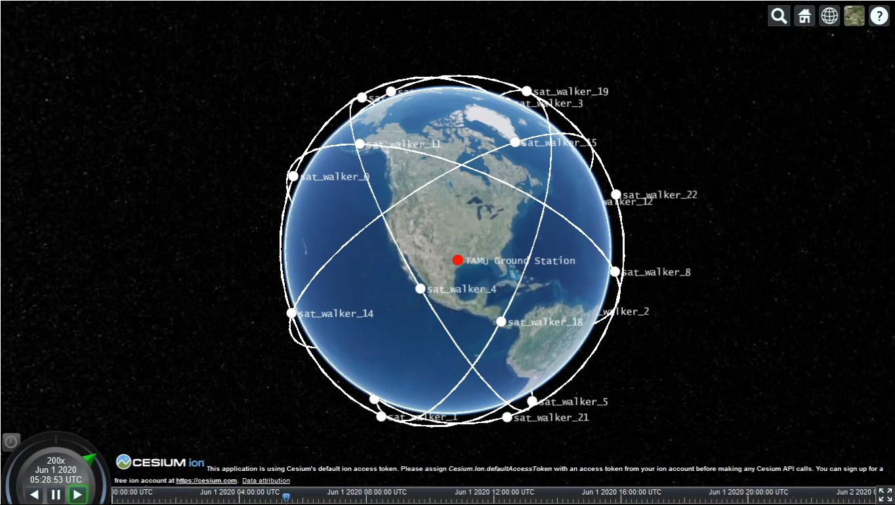
TAMU team – Work done so far
Worked on defining an Earth Observation example scenario
Mission is to provide measurements of a certain observable, e.g., launch detection with certain properties (e.g., accuracy, spatial resolution)
Various platforms (air, space, ground) have different kinds of sensors with complementary capabilities (e.g., microwave, infrared)
Platforms autonomously decide whether to join a mission or not based on
Knowledge Graph (global knowledge of physics, which sensors can measure what + local knowledge about this agent’s capabilities)
Mission specification
Worked on simulation framework for demo using Orekit + Cesium

Slide 2
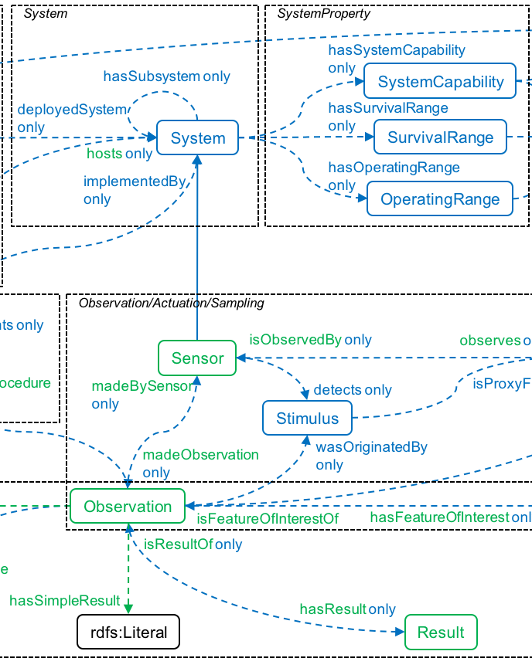
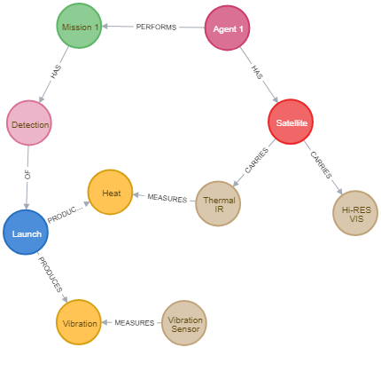
TAMU team – Work done so far
Researched potential ontologies to use in the KG (Semantic Sensor Network Ontology)
Researched KG development tools (chose Neo-4j over grakn) and developed example knowledge graph
Researched potential corpuses of data to mine to complete the KG (adafruit, CEOS database) and approaches for link prediction (embeddings)
Researched Markov Logic Networks as a means to incorporate uncertainty in the KG (prac-mln library)
SSN ontology
Example KG

Slide 3
TAMU team – next steps
Continue developing KG including automatic graph completion from existing corpuses
Continue developing Orekit+Cesium simulation framework
Generate MLN program from the KG and the problem formulation
Explore connections with Markov Decision Processes and temporal logics (PLTL/PCTL) with Cornell team
Compare pure MLN approach to planning-based approach

